Slide 1
Desired Business Outcomes - Moving to a Modern Data Architecture
Retain front end tool availability and choice
At a minimum, retain the current UI experience we have from Power BI and MS Excel
Further improve and speed up end user self service capability
Continue to improve new solution delivery agility and speed
Continue to improve report and query performance at any scale
Further expand the data sets that are available for analytics from a primary focus on ERP, to manufacturing, digital marketing and other external data sets
Enable fast advanced analytics experiments and deployments (ML, AI, etc)
Intensify “data freshness” for analytics
Increase amount of information available in RT/NRT versus batch loading of data for Analytics
Increase BI FTE availability for innovation activity versus run and maintain
Continue to drive down TCO

Slide 2
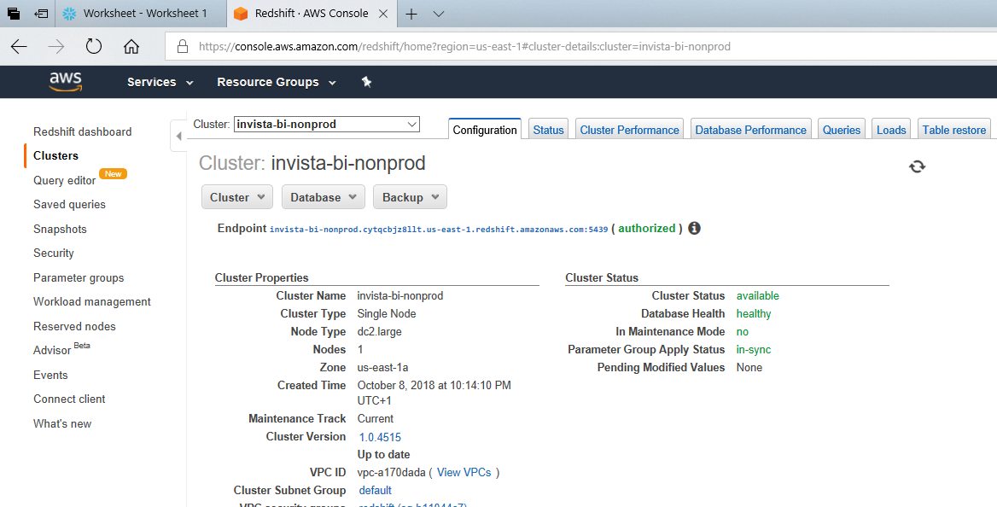
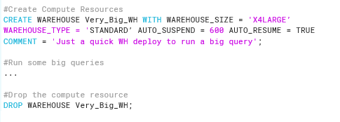



Infrastructure Management
Cluster sizes can be changed from the AWS Console
But you still need to manually manage and not that easy to scale up and down on the fly
Some automation is on the roadmap
Incur cost even when not being used
Snowflake compute resources can be spun up on the fly in code
Easily dropped and cost removed when not needed
Specific compute cost can be easily allocated to different users, applications and businesses
Enterprise edition can be configured to auto-scale up and down
Desired Business Outcomes
Further improve and speed up end user self service capability
Continue to improve new solution delivery agility and speed
Increase BI FTE availability for innovation activity versus run and maintain
Continue to improve report and query performance at any scale
Continue to drive down TCO
Enable fast advanced analytics experiments and deployments (ML, AI, etc)

Slide 3
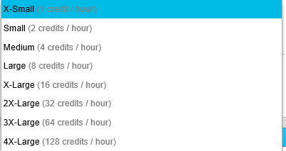

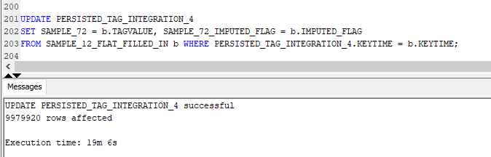
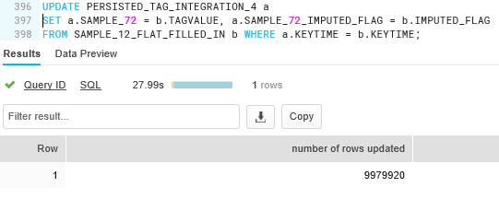
Performance – Smallest Redshift v’s Smallest Snowflake
But likely per other sources, with the appropriate sizing and setup (see next slide) the same performance can be achieved – not so much a focus area for us and we did not have the time to start experimenting with different Redshift cluster sizes.
Desired Business Outcomes
Further improve and speed up end user self service capability
Continue to improve new solution delivery agility and speed
Continue to improve report and query performance at any scale
Intensify “data freshness” for analytics
Continue to drive down TCO
Enable fast advanced analytics experiments and deployments (ML, AI, etc)

Slide 4
Support and Development Skill Set
Design Considerations
Sort Keys (determine effectiveness of zone maps)
Queries patterns need to match sort key decisions to be optimal
Distribution Style
Determines how table rows are distributed to slices for parallelism
Column Compression Encoding
Vacuuming and Statistics updates
S3 Files need to be optimized in size for Redshift Slices
1MB to 1GB after Gzipping
Design Considerations
Nothing significant
Column compression, key management and vacuuming all automatic
Desired Business Outcomes
Further improve and speed up end user self service capability
Continue to improve new solution delivery agility and speed
Continue to improve report and query performance at any scale
Continue to drive down TCO
Enable fast advanced analytics experiments and deployments (ML, AI, etc)

Slide 5
Pricing Models
On-demand pricing and volume discounts available
Charges per-hour per-node
covers both computational power and data storage
Monthly Price = Price/Hr * Cluster Size * Hrs in month
Pricing
Dense Compute
DC1.Large (2 CPUs, 0.16TB SSD) = $0.250/hr
DC1.8xLarge (32 CPUs, 2.56TB SDD) $4.800/hr
Dense Storage
DS2.Large (4 CPUs, 2TB HDD) = $0.850/hr
DS2.8xLarge (36 CPUs, 16 TB HDD) = $6.800/hr
Additional S3 data transfer charges
You can shutdown Redshift cluster when not in use but has to be done via API or AWS Console – not practical for global usage pattern
On-demand pricing and volume discounts available
Pricing bills at hour granularity for each virtual warehouse
depends heavily on your usage pattern because no charge for compute when no queries
Data storage is decoupled from the computational warehouses
Billed separately at $23 per TB per month
7 different tiers of computational warehouses
The smallest cluster, X-Small, costs one credit per hour, or $2/hour.
At each level, the number of credits per hour doubles
Dynamic pricing model
clusters will stop when no queries are running and automatically resume when they are
can flexibly resize themselves based on a changing workload
Desired Business Outcomes
Continue to drive down TCO

Slide 6
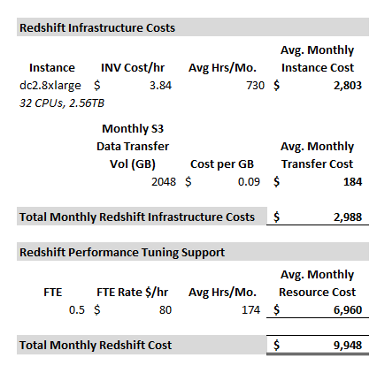
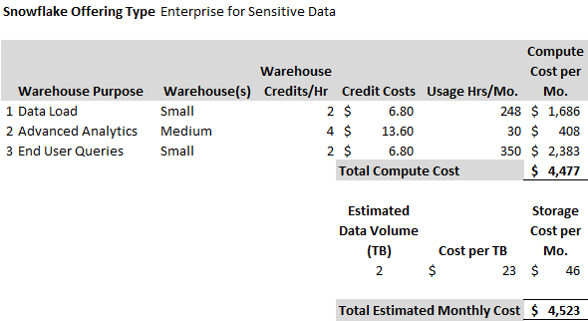
Cost
Desired Business Outcomes
Continue to drive down TCO

Slide 7
User Experience
Tested connecting PowerBI to both offerings, querying the same dataset (70 tags for 20 years = 10.5MM records and 72 columns)
Functionality experience was identical between both tools, both for LiveQuery connection and Data Import
Largest difference between both tools was the performance of the queries executed in PowerBI
Test executed on X-Small
Test executed on dc2.large
Data Import – all records of the dataset
Snowflake Query Time = 32 sec
Live Query Line Chart
Snowflake Query Time = 8 sec
Data Import – all records of the dataset
Redshift Query Time = 16m 11 sec
Live Query Line Chart
Redshift Query Time = 11 sec
Test executed on X-Large
Data Import – all records of the dataset
Snowflake Query Time = 5 sec
Live Query Line Chart
Snowflake Query Time = 8 sec
Desired Business Outcomes
Retain front end tool availability and choice
At a minimum, retain the current UI experience we have from Power BI
Further improve and speed up end user self service capability
Continue to improve report and query performance at any scale
Further expand the data sets that are available for analytics from a primary focus on ERP, to manufacturing, digital marketing and other external data sets
Enable fast advanced analytics experiments and deployments (ML, AI, etc)

Slide 8
Security and Accessibility (per KBS Evaluation)
Redshift must live in a VPC and the company is responsible for network access controls
Today, this makes Redshift difficult to access from on-prem unless deployed to a Legacy IAM account
Snowflake will be multi-cloud (AWS/Azure at least, GCP unknown); Redshift will never be in any cloud provider other than AWS
Snowflake is SaaS and therefore can be accessed from anywhere via URL without regards to network layer controls
Desired Business Outcomes
Accuracy and the right Security constraints are a given

Slide 9
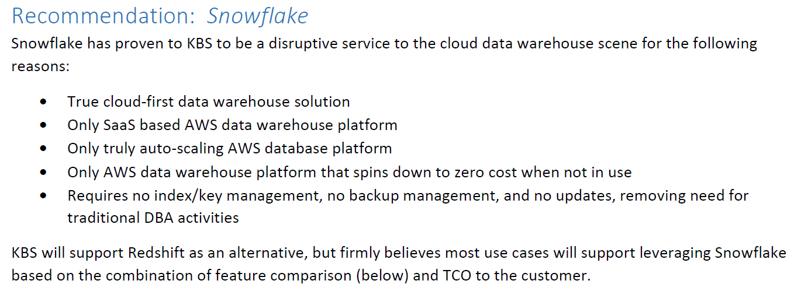
KBS Recommendation

Slide 10
Our Conclusions
Per our previous slides, in terms of meeting our Desired Business Outcomes, Snowflake gives us the best chance of being successful

Slide 11
Backup Charts

Slide 12
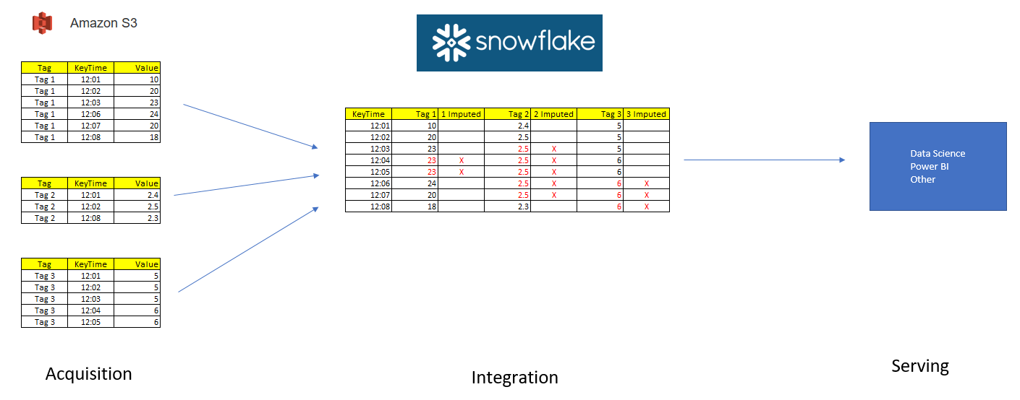
POC – High Level Example

Slide 13
POC Implementation
Leverage the same meta data we are using to drive our Tag ingestion process
This defines our tags and their acquisition S3 bucket locations
Extend model to define the concept of Integration data sets
Sets of tags to be brought together
Start and End Time Periods
Aggregation level for final data set
Use Python to orchestrate and auto-gen the code for integration
Final output is a consolidated table/view for consumption by ML and UI tools
Test at “reasonable” scale
Final test data set of 72 tags x 19 years x 1 minute intervals

Slide 14

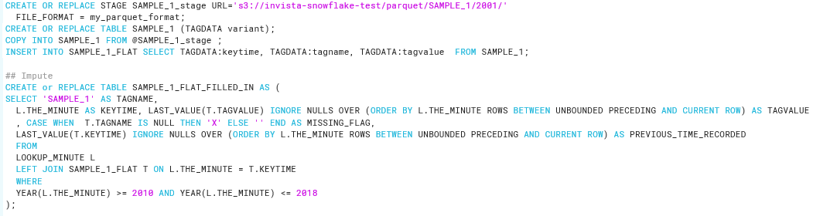
POC High Level Implementation
Power BI
Legacy
Data
…
Geo
Spatial
Web
External
Data
Python
Ingestion
Code
Social
Machine
IOT
OLTP
Data
Data Lake
…
Load
Transform
Meta
Data
Python
Integration
Code
Data
Warehouse
Example
Auto-generated
instructions to Snowflake

